Slide 1
Financial Accounting
IFRS 5th Edition
Weygandt ● Kimmel
Chapter 1
Accounting in Action
This slide deck contains animations. Please disable animations if they cause issues with your device.
Copyright © John Wiley & Sons, Inc.

Slide 2
Chapter Outline
Learning Objectives
LO 1 Identify the activities and users associated with accounting.
LO 2 Explain the building blocks of accounting: ethics, principles, and assumptions.
LO 3 State the accounting equation, and define its components.
LO 4 Analyze the effects of business transactions on the accounting equations.
LO 5 Describe the five financial statements and how they are prepared.

Slide 3
How you can be a successful student
Self-learning is very important
Utilize tutorial & HW questions
Prepare your own notes
It helps you digest knowledge
Don’t procrastinate until very end to submit assignments
Things pile up very quickly
Approach TAs and USTFs!
They were selected because they did well in the course.

Slide 4
Learning Objective 1 Identify the activities and users associated with accounting.
L O 1

Slide 5
What do you think of accounting?
Common perceptions
Accounting is boring
Can be true in beginning. Has lot of concepts & assumptions that you must grasp.
But it can be interesting if you learn to connect the dots – i.e., link concepts to real-world examples
Accounting is useless
You will use accounting to understand how businesses speak to investors

Slide 6
What is Accounting?
Accounting is the process of identifying, measuring, recording, and communicating economic events in order to provide information for decision-making purposes.
It is the language of businesses!
There are two primary types of accounting systems:
financial accounting (provides information to decision-makers external to the firm)
Managerial accounting (provides information to decision-makers internal to the firm)

Slide 7
When do we use accounting?
Companies will publish information according to guidelines
Guidelines are called GAAP (Generally Accepted Accounting Principles)
Other countries use IFRS (International Financial Reporting Standards)
You will use accounting to understand these information to make useful decisions
Decisions as an investor
Decisions as an entrepreneur

Slide 8
Is accounting easy?
Not necessarily.
It may be difficult in the beginning.
You have to know concepts & framework.
Think of it as learning when to add & subtract.
It will become easy as you learn!

Slide 9
What are three accounting activities?
Accounting is the process of identifying, measuring, recording, and communicating economic events in order to provide information for decision-making purposes.
It is the language of businesses!
They use the same language to communicate their performance

Slide 10
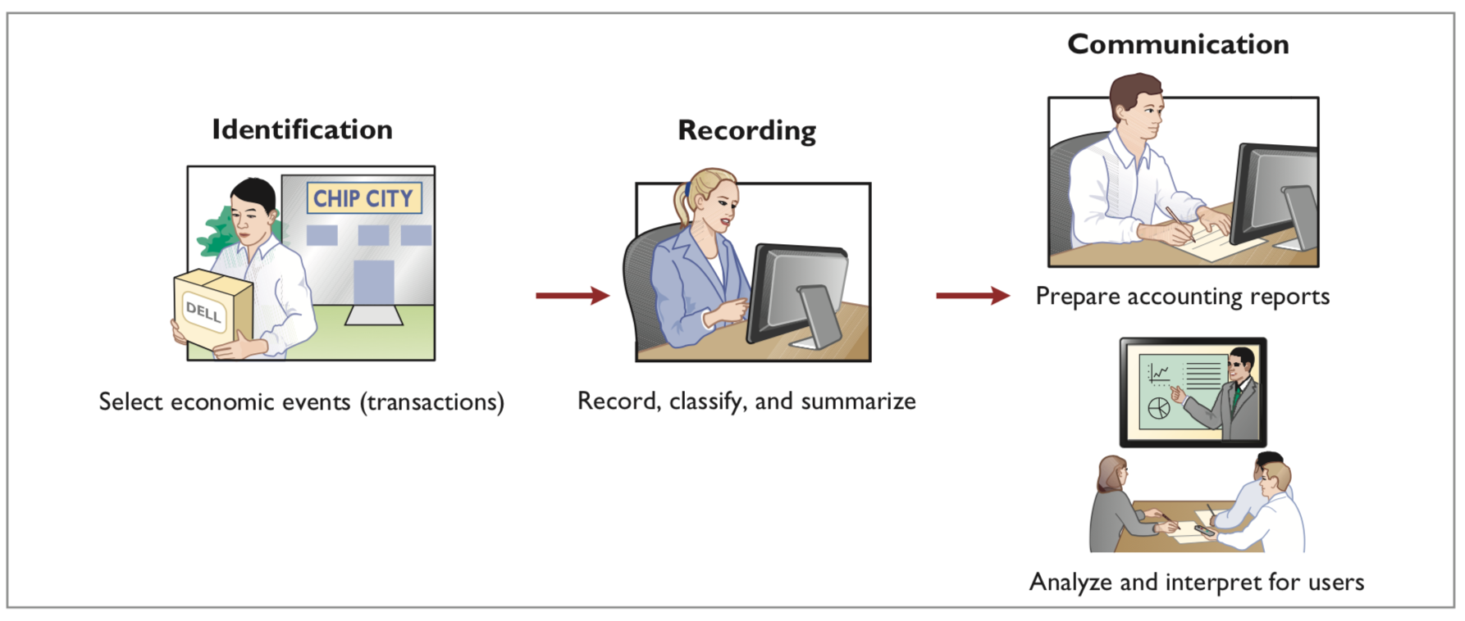
Accounting Activities Illustrated
Three Activities
Illustration 1.1: The activities of the accounting process.
L O 1
Notes:
Identificaoitn: Identify what information to be recorded. Not everything is recorded. Only information that is related to financial performance is recorded.
Recording: Use guidelines to record the numbers (e.g., US GAAP, IFRS)
Communication: Accountants communicate the information (e.g., Apple’s 10K)

Slide 11
Who uses accounting information?
Internal: Managers who plan, organize, and run the business.
Rely on managerial accounting for decision-making.
Examples: Marketing, production, finance managers.
External: Users outside of the organization.
Rely on financial accounting for decision-making.
Examples: Investors and creditors.
L O 1

Slide 12
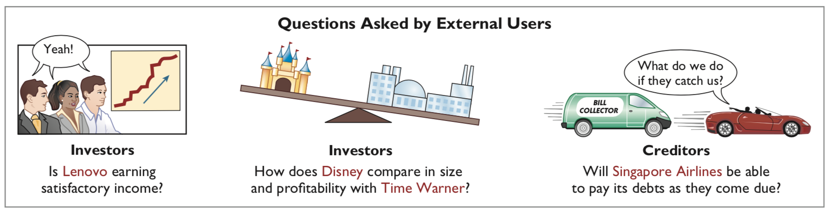
External Users
Illustration 1.3: Questions that external users ask.
L O 1

Slide 13
Evidence That Accounting Information is Important to Investors
Stock price reaction to earnings announcements
JAN 25th, 2023: Electric vehicle maker Tesla reported earnings after the bell, beating on both earnings and revenue. Shares rose more than 5% after hours after CEO Elon Musk said the company might be able to produce 2 million cars this year. Here are the results.
Earnings (adjusted): $1.19 vs $1.13 per share expected, per Refinitiv
Revenue: $24.32 billion vs $24.16 billion expected, per Refinitiv.
In the year-ago quarter, Tesla reported revenue of $17.72 billion
https://www.cnbc.com/2023/01/25/tesla-tsla-earnings-q4-2022.html

Slide 14
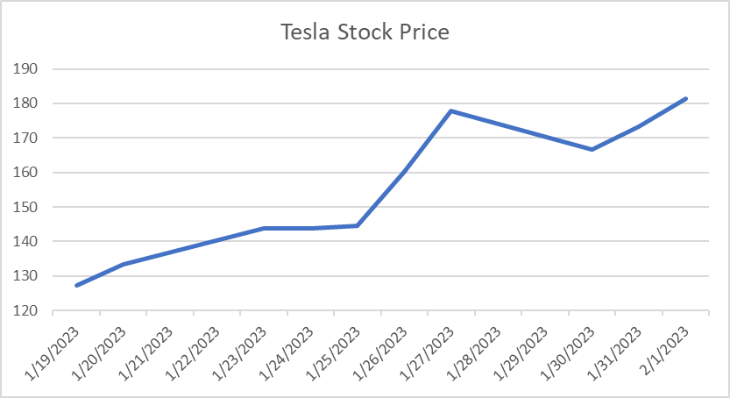
Evidence That Accounting Information is Important to Investors
Stock price reaction to earnings announcements
Date | Price
1/19/2023 | 127.17
1/20/2023 | 133.42
1/23/2023 | 143.75
1/24/2023 | 143.89
1/25/2023 | 144.43
1/26/2023 | 160.27
1/27/2023 | 177.9
1/30/2023 | 166.66
1/31/2023 | 173.22
2/1/2023 | 181.41

Slide 15


Slide 16
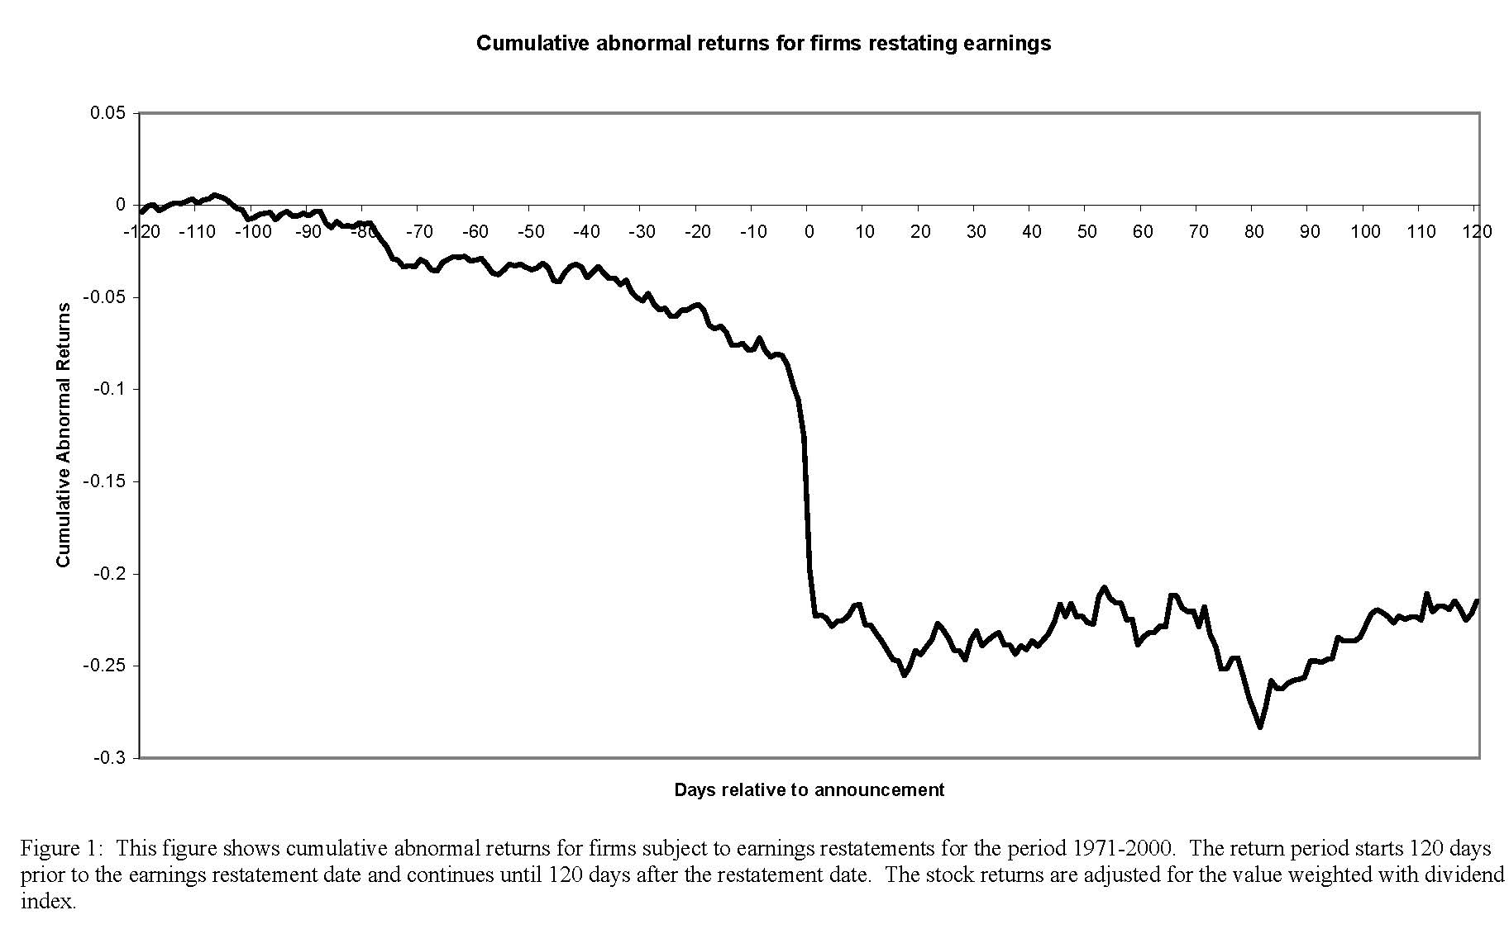
Evidence That Accounting Information is Important to Investors
Cumulative returns around earnings restatements

Slide 17
How Do Creditors (e.g., banks) Use Accounting Information?
Debt contract
I am CEO of Apple. Want to make improvements to the iPhone.
I take out a $100M loan from Chase
In the debt contract, I am making a promise
I will keep paying interest on time
I will keep my leverage ratio below a certain amount
If these are violated, Chase may increase the interest rate / make me pre-pay the loan before maturity
L O 1

Slide 18
Specific Example
Many aspects of debt contracts are based on accounting information:
Interest rate charged
Nature of debt covenants imposed
Example (Vertex Pharmaceuticals):
On October 13, 2016, we entered into a Credit Agreement…with Bank of America…Under the Credit Agreement, the applicable margin on base rate loans ranges from 0.75% to 1.50%...based on our consolidated leverage ratio (the ratio of our total consolidated funded indebtedness to our consolidated EBITDA for the most recently completed four fiscal quarter period). The Credit Agreement contains customary representations and warranties and affirmative and negative covenants, including financial covenants to maintain (x) subject to certain limited exceptions, a consolidated leverage ratio of 3.00 to 1.00 and (y) consolidated EBITDA of at least $200 million, in each case to be measured on a quarterly basis.

Slide 19
Additional External Users
Taxing authorities: Does the company comply with the tax laws?
Regulatory agencies: Is the company operating within prescribed rules?
Labor unions: Does the company have the ability to pay increased wages and benefits to union members?
https://onlinelibrary.wiley.com/doi/full/10.1111/j.1911-3846.2012.01160.x
L O 1

Slide 20
Let’s put everything together
I want to open a coffee shop
What do you need?
Internal transactions related to
Machine
Employees
Inventories and supplies (coffee beans, cups, straws etc.)
External transactions related to
Shareholders (owners)
Creditors (e.g., banks)
Suppliers
Customers

Slide 21
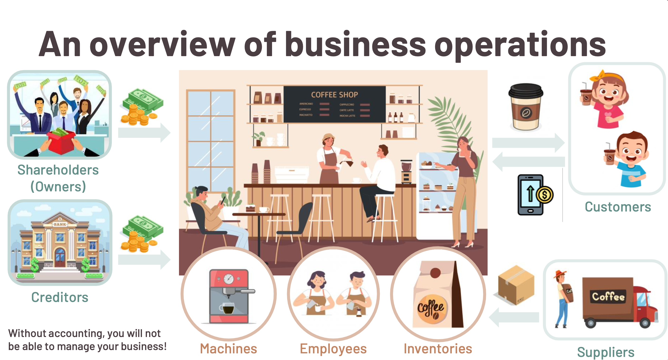
Notes:
Shareholders: input their own money → own the company, if company makes profit, they share upside
Creditors: borrower money (banks) → you pay interest back and pay the debt back
After you obtain money, you start the business!
Buy machine, hire employees, and buy inventories from supplier
Then you sell the coffee to your customers (they pay you money)
After you collect money, you can expand business; pay back creditor; pay dividends to shareholders
In all steps, you need accounting knowledge because recording involved. You can use accounting to track performance.

Slide 22
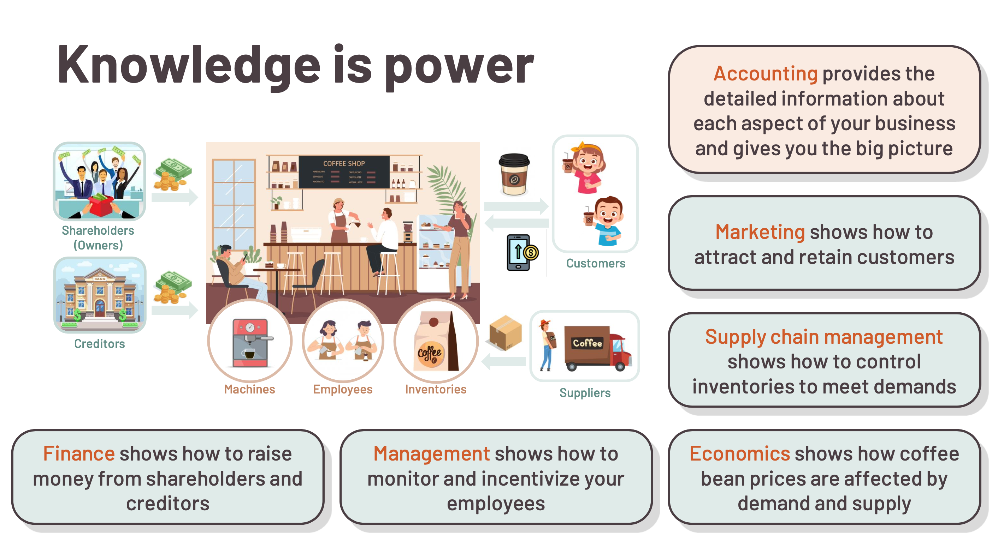

Slide 23
Accounting is strange, but only at beginning!
Reasons
Abstract concepts
Accounting equation is not intuitive
Double-entry bookkeeping is complex
Solutions
Link real-world examples to accounting concepts
Practice on your own!
Utilize TA / USTF office hours

Slide 24
About this course
WileyPlus
Tutorial questions
Unlimited attempts for each set
TA / USTF will record tutorial for each chapter
Watch and follow along
Homework assignments
Have three attempts for each set – we will keep highest score
Do them independently
Review Sessions (before mid-term and final)
Onsite sessions will be assigned on SIS
We will make announcements later
Office hours
Bring questions to TA / USTF
We will make announcement later

Slide 25
Grades
Tutorial: 10% (On WileyPlus)
HW: 20% (On WileyPlus)
Mid-term: 30% (Closed-book, closed notes)
3/18/2024
Final: 40% (Closed-book, closed notes)
5/13/2024

Slide 26
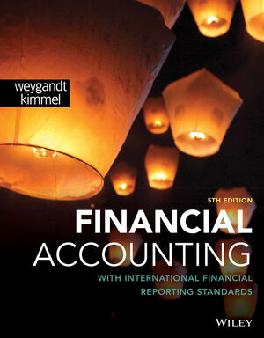
Instructions on WileyPLUS

Slide 27
Agenda
Create your WileyPLUS account
Find your course ID of ACT2111 on WileyPLUS
Start with the 14-day temporary access
Purchase a registration code and activate your account
Notes: WileyPLUS is an e-learning system (not just a textbook). It is compulsory for students enrolled in ACT2111 to use this system. Students are required to complete the tutorial questions and homework assignments on this e-learning system.

Slide 28
1 Create a student account on WileyPLUS
Go to https://education.wiley.com/ngonboard/index.html#/signup
In the “First name” box, please enter your full name
please type your name in English
In the “Last name” box, please enter your student ID
In the “Email address” box, please enter your university email
If you cannot open the webpage, please install and run the CUHKSZ VPN first
https://itso.cuhk.edu.cn/en/node/169
Please seek help from ITSO if you encounter any issues installing the VPN

Slide 29
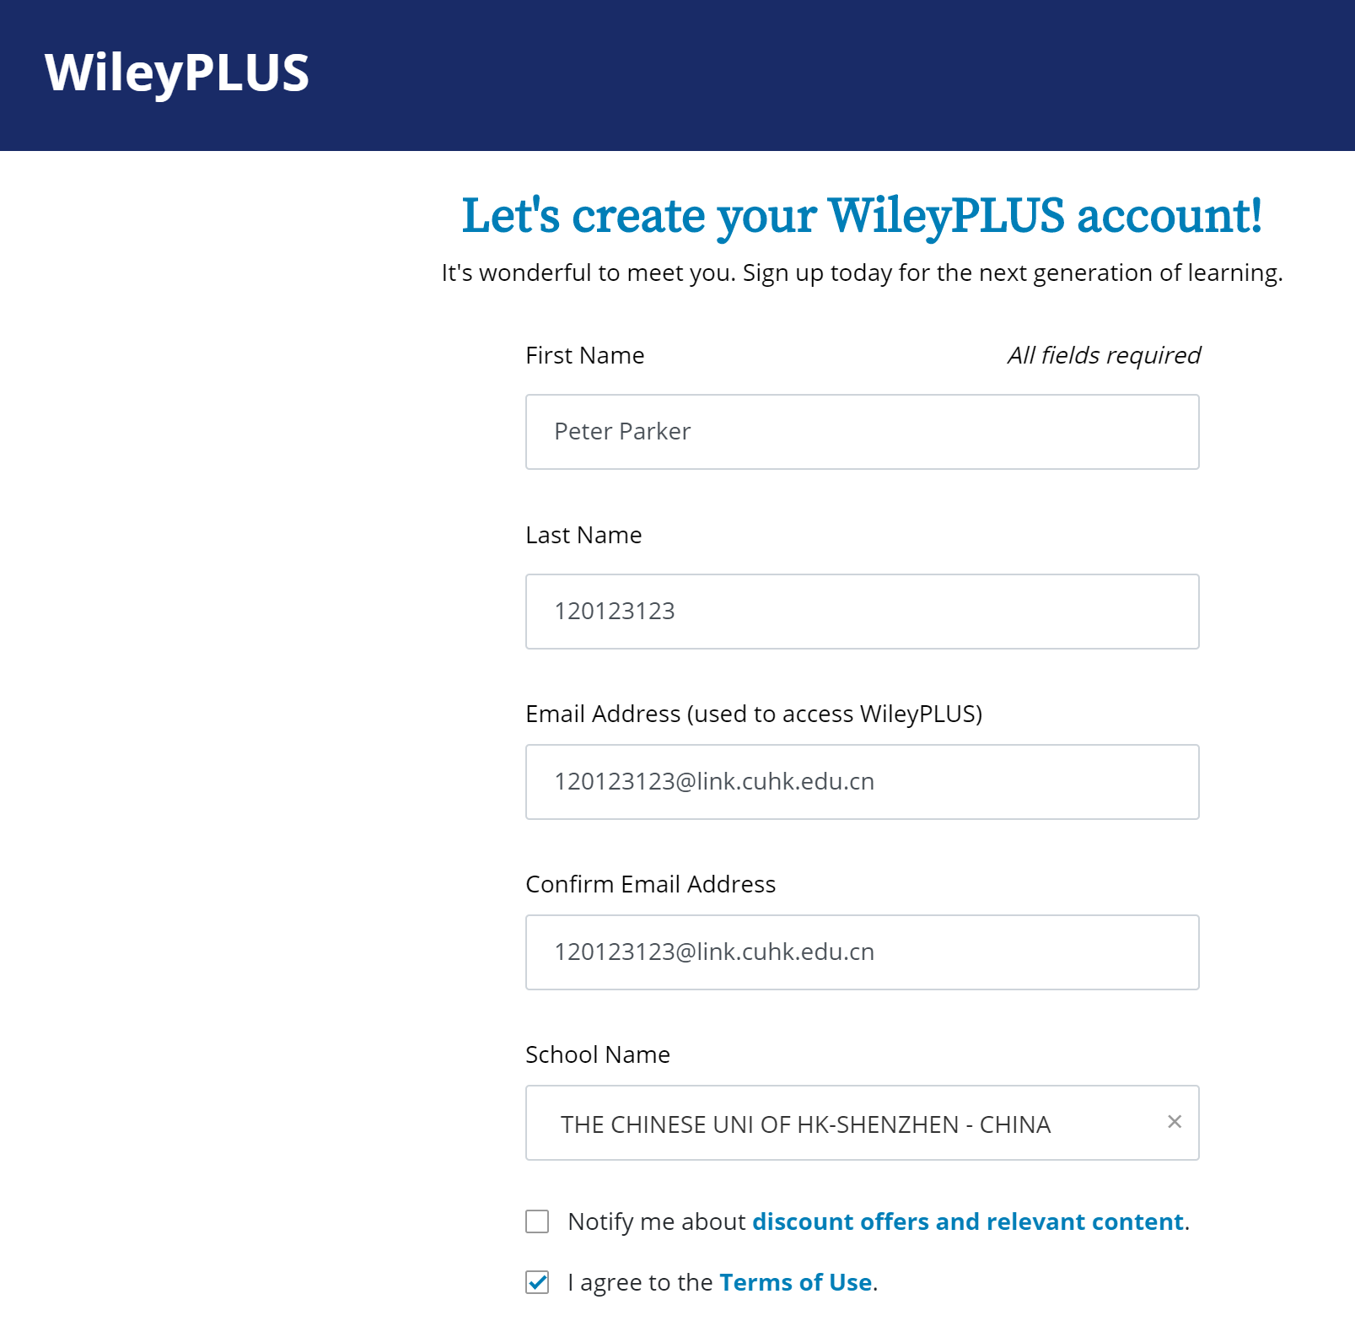
Enter your full name here
(please type your name in English)
Enter your student ID here
Enter your university email here
Choose our university name

Slide 30

2 Find your course section ID
Prof. Joon Sang Yoon: B40811
Different instructors have different section IDs. Make sure you enter a correct section ID.
B40811

Slide 31
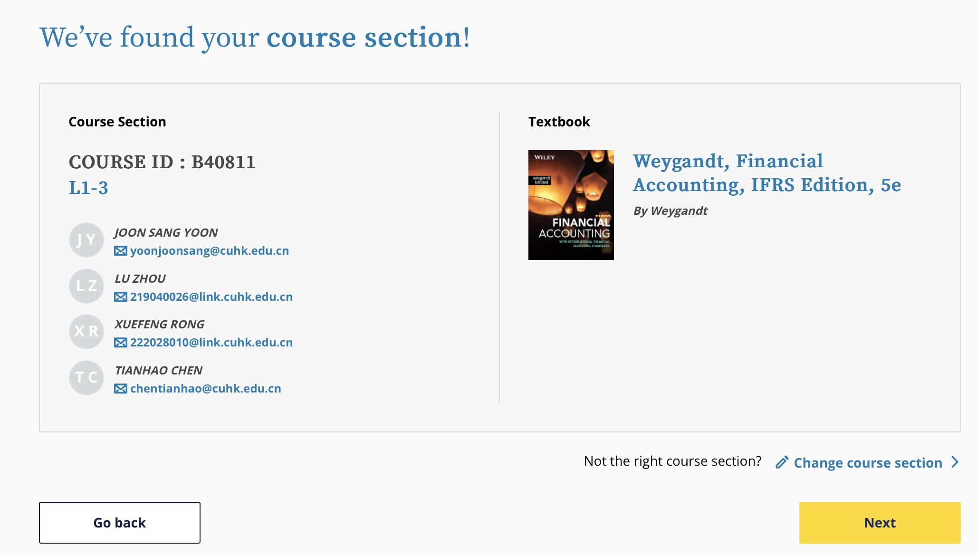
Please double check your instructor’s name

Slide 32
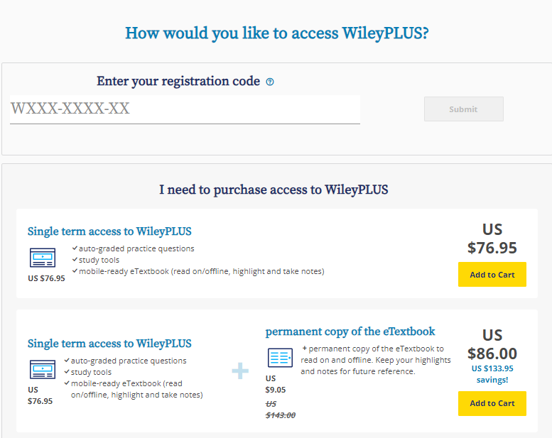

3. Start with the 14-day temporary access
Second, after you have purchased and received the registration code, you can activate your account and use it for the entire term.
Ignore these options as they are for other countries outside China
First, please click here!
Before you receive the registration code (or if you have not decided to join this course), this allows you to use the 14-day free trial.

Slide 33
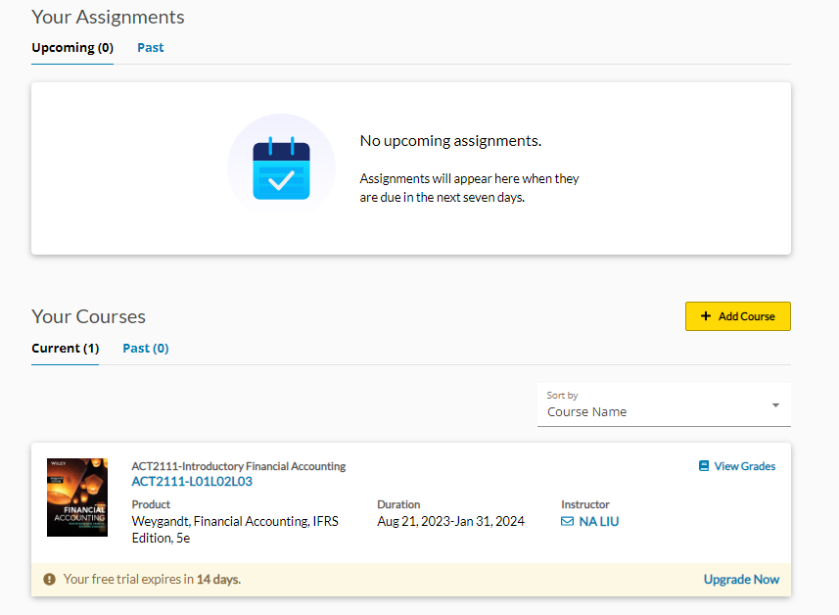
A temporary student account can only be used for 14 days. After receiving the access code, you can upgrade it from here.

Slide 34
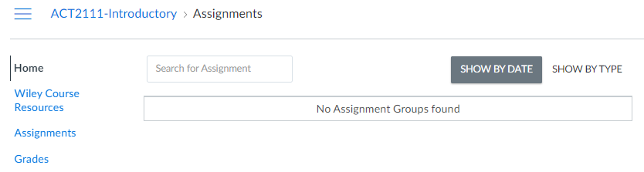
Click here to view the eTextbook
Notes:
A self-assessment tool

Slide 35
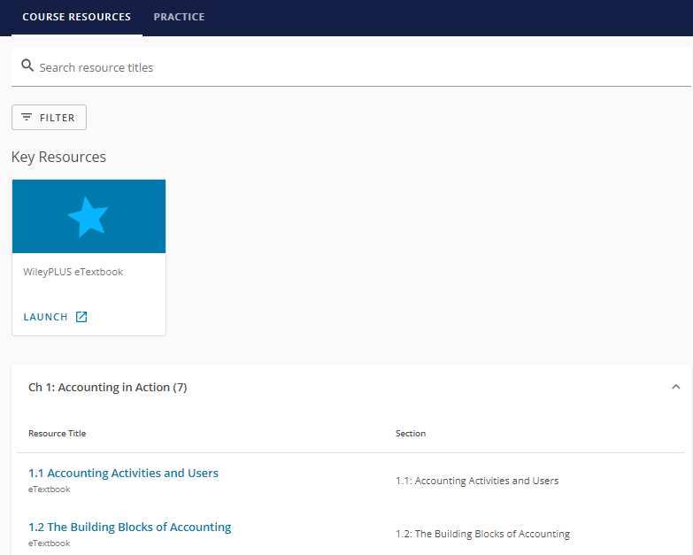
Click here to view the whole eTextbook
Click here to view individual sections
Notes:
A self-assessment tool

Slide 36
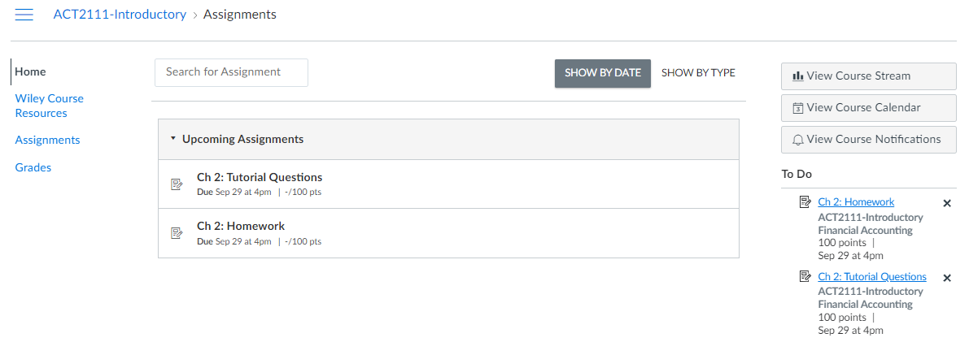
Questions to be covered in the tutorial videos (unlimited attempts)
Homework assignments (three attempts)
Tutorial questions and homework assignment for each chapter will be released every one or two weeks (Visible only after the assignments are released)
Notes:
A self-assessment tool

Slide 37
How do I access WileyPLUS after registration?
After registration, you may log in WileyPLUS via the following link using your user name and password
www.wileyplus.com/go/login

Slide 38
When do I need to make the purchase?
If you have decided to take the course, you may register your account and make the purchase as early as possible, to avoid the delay in submitting your homework assignments.
If you haven’t decided whether to stay in the course, you may postpone both the registration and the purchase. Meanwhile, please make sure you do not miss the due date of the first assignment.

Slide 39
When do we get the access code?
The 14-day free trial period of the system lasts for 14 days from the date of your online registration.
The payment is not refundable.

Slide 40
How do we get the access code?
Upon receiving your order, the vendor will need several working days to process the order and obtain the registration codes from the Wiley publisher. After that, our school will receive their codes and our TAs will send the codes to each student via BB. During the waiting period, you can use the 14-day free trial to access WileyPLUS.

Slide 41
Learning Objective 2 Explain the building blocks of accounting: ethics, principles, and assumptions.
L O 2

Slide 42
Accounting Standards
Ensure high-quality financial reporting.
Primary accounting standard-setting bodies:
International Accounting Standards Board (IASB)
Determines International Financial Reporting Standards (IFRS)
Used in more than 150 countries
Financial Accounting Standards Board (FASB)
Determines generally accepted accounting principles (GAAP)
Used by most companies in the U.S.
L O 2

Slide 43
Measurement Principles
IFRS generally uses one of two measurement principles, the historical cost principle or the fair value principle.
Historical cost principle (or cost principle): dictates that companies record assets at their cost. This is true not only at the time the asset is purchased, but also over the time the asset is held.
Fair value principle: states that assets and liabilities should be reported at fair value (the price received to sell an asset or settle a liability), value in use (present value of future cash flows), or current cost (replacement cost).
L O 2

Slide 44
Selecting Measurement Principles
Selection of which principle to follow generally relates to trade-offs between relevance and faithful representation.
Relevance means that financial information is capable of making a difference in a decision.
Faithful representation means that the numbers and descriptions match what really existed or happened—they are factual.
L O 2

Slide 45
Assumptions
Assumptions provide a foundation for the accounting process. Two main assumptions are the monetary unit assumption and the economic entity assumption.
Monetary unit assumption: requires that companies include in the accounting records only transaction data that can be expressed in money terms.
If a transaction cannot be expressed in dollar value, it should not be included in the company's financial books. It is considered useless for financial accounting purposes. i.e., CEO reputation, customer royalty, etc, should not be recorded.
L O 2

Slide 46
Assumptions
Economic Entity Assumption: requires that the activities of the entity be kept separate and distinct from the activities of its owner and all other economic entities.
Business entities to be treated as separate legal and financial entities. Typical entity forms are proprietorship, partnership, corporation.
This means that you must maintain separate accounting records and bank accounts for each entity, and not intermix with them the assets and liabilities of its owners or business partners. (i.e., CEO’s account is not the company’s account)

Slide 47
DO IT! 2: Building Blocks of Accounting
Indicate whether each of the five statements presented below is true or false. If false, indicate how to correct the statement.
Ethics are the standards of conduct by which actions are judged as right or wrong, honest or dishonest, fair or not fair.
The primary accounting standard-setting body headquartered in London is the International Accounting Standards Board (IASB).
An asset recorded using the historical cost basis results in recording assets at their cost. In later periods, however, the current value of the asset must be used if current value is higher than its cost.
Relevance means that financial information matches what really happened; the information is factual.
A business owner’s personal expenses must be separated from expenses of the business to comply with accounting’s economic entity assumption.
L O 2

Slide 48
DO IT! 2: Building Blocks of Accounting – Solution
True.
True.
False. Assets recorded using the historical cost basis are not adjusted in later periods to current value. They remain at their original cost.
False. Faithful representation means that financial information matches what really happened; the information is factual.
True.
L O 2

Slide 49
Learning Objective 3 (IMPORTANT) State the accounting equation, and define its components.
L O 3

Slide 50
The Accounting Equation
The Basic Accounting Equation
Assets | = | Liabilities | + | Owner’s Equity
Illustration 1.6: The basic accounting equation.
Assets: resources a business owns.
Liabilities: claims against assets, i.e. existing debts and obligations.
Owner’s Equity: the ownership claim on a company’s total assets.
A = L + OE
L O 3

Slide 51
Left-hand side: Asset
Assets | = | Liabilities | + | Owner’s Equity
Resources that a business owns
Can provide future services or economic benefit
Examples
Cash
Equipment
Building
Inventory
Receivables

Slide 52
Right-hand side: Liabilities
Assets | = | Liabilities | + | Owner’s Equity
Creditor’s claims on assets
Examples
Bank loan
Payable to supplier
Payable to employee
These are existing obligations and are unavoidable

Slide 53
Right-hand side: Owner’s Equity
Assets | = | Liabilities | + | Owner’s Equity
Owner’s claims on assets
Two parts to owner’s equity
Contributed Capital: Owner’s money that was put into the business (sometimes called share-capital ordinary)
Retained Earnings: Income earned and kept

Slide 54
Retained earnings
Income earned and kept. What is income?
Revenues: are the gross increases in equity resulting from business activities entered into for the purpose of earning income. Revenues usually result in an increase in an asset.
Things “earned”
Expenses: are the cost of assets consumed or services used in the process of earning revenue.
Things “used up”
Revenue – Expense = Income
Dividends: are distribution of cash or other assets to shareholders. They are not expenses.
L O 3

Slide 55
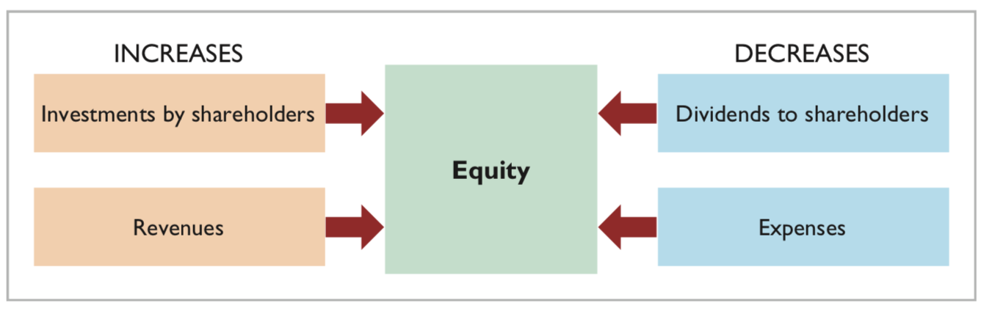
Equity Illustrated
Illustration 1.7: Increases and decreases in equity.
L O 3
Notes:
Revenue: You sell stuff to customers… things “earned”
Expense: Necessary costs you need to pay to sustain business … things “used up”

Slide 56
DO IT! 3: Equity Effects
Classify the following items as issuance of shares (I), dividends (D), revenues (R), or expenses (E). Then indicate whether each item increases or decreases equity.
Rent Expense
Service Revenue
Dividends
Salaries and Wage Expense
L O 3

Slide 57
DO IT! 3: Equity Effects – Solution
Rent Expense is an expense (E); it decreases equity.
Service Revenue is a revenue (R); it increases equity.
Dividends is a distribution to shareholders (D); it decreases equity.
Salaries and Wages Expense is an expense (E); it decreases equity.
L O 3

Slide 58
Learning Objective 4 IMPORTANT Analyze the effects of business transactions on the accounting equation.
L O 4

Slide 59
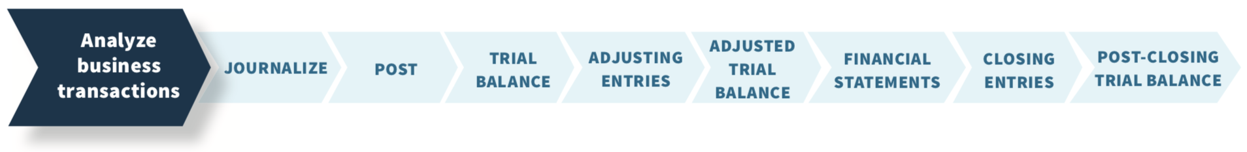
Analyzing Business Transactions
Accounting Information System:
The system of collecting and processing transaction data and communicating financial information to decision-makers.
The steps companies follow each period to record transactions and eventually prepare financial statements:
L O 4

Slide 60
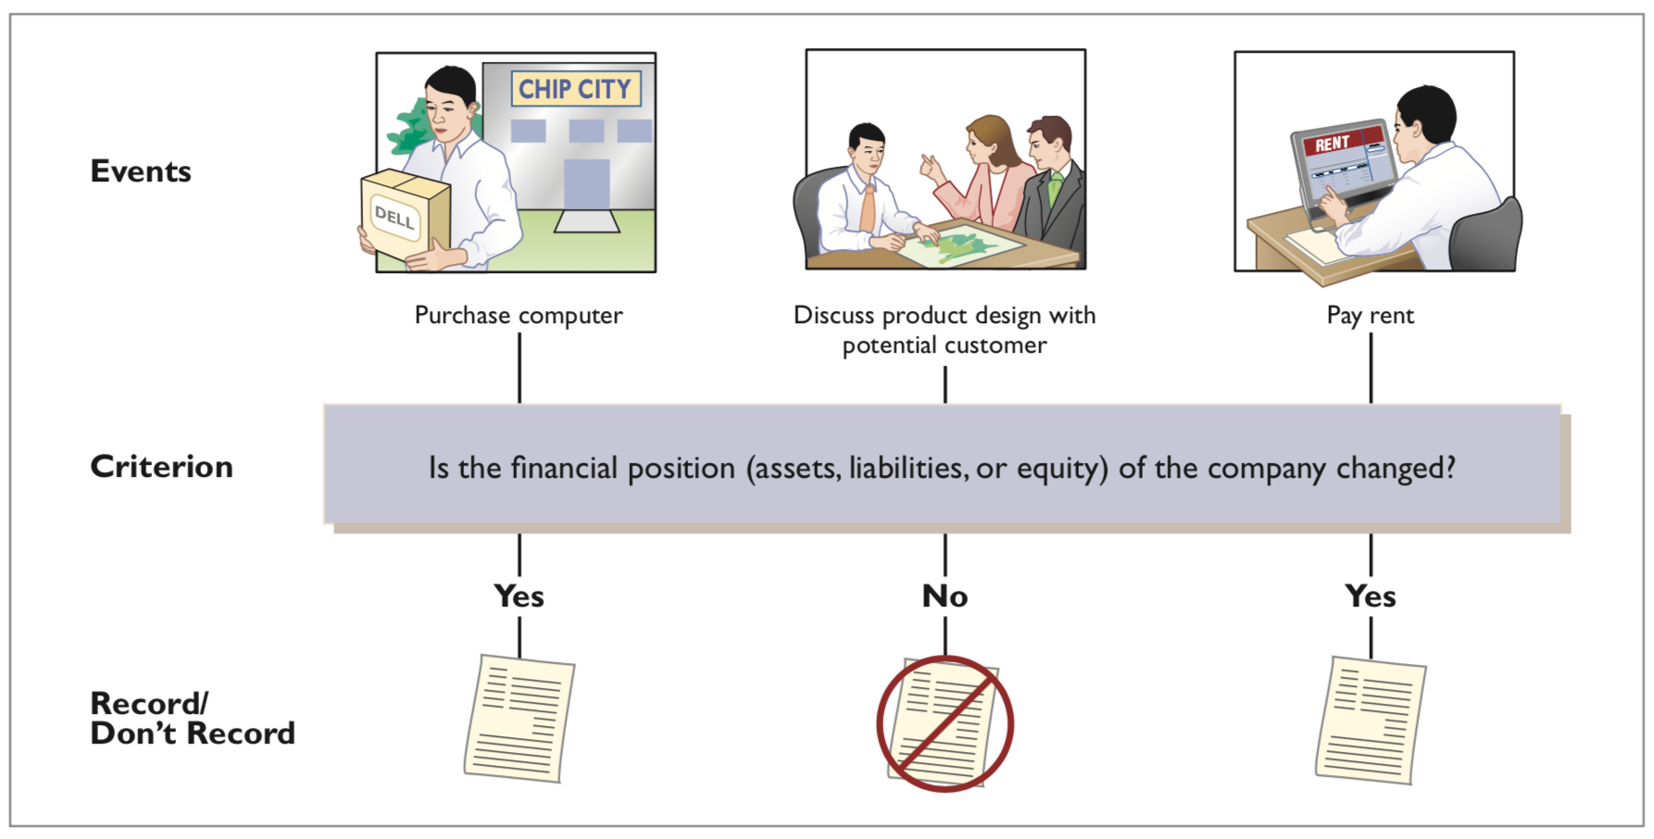
Accounting Transactions
Illustration 1.8: The transaction identification process.
L O 4
Notes:
Skip

Slide 61
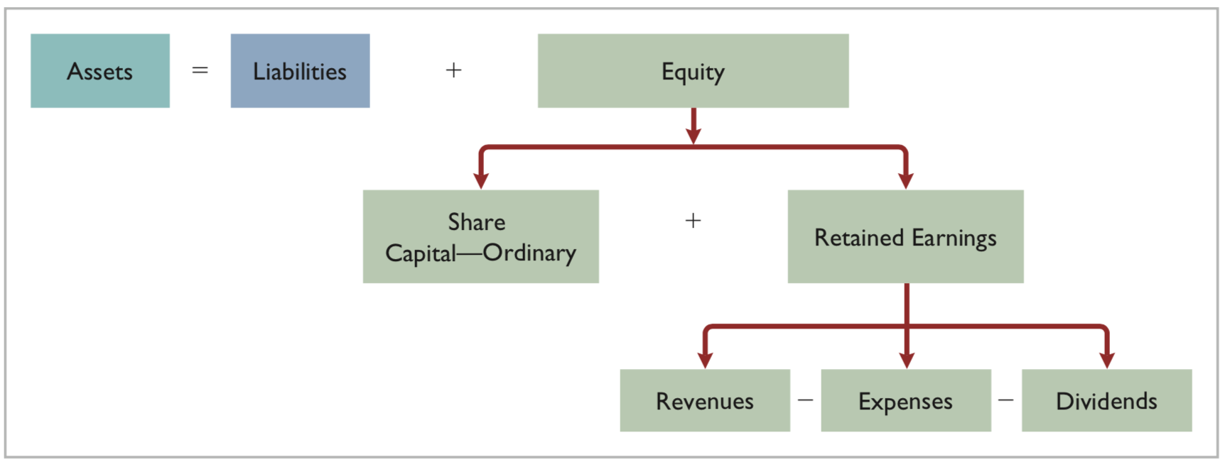
Transaction Analysis
Illustration 1.9: Expanded accounting equation.
L O 4

Slide 62
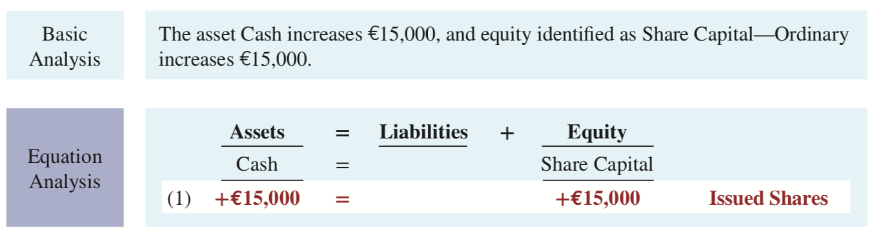
Transaction (1). Investment by Shareholders.
Assume: Ray and Barbara Neal decide to start a smartphone app development company that they incorporate as Softbyte SA. On September 1, 2025, they invest €15,000 cash in the business in exchange for €15,000 of ordinary shares. The ordinary shares indicates the ownership interest that the Neals have in Softbyte SA.
Demonstrate: Basic and equation analysis of this transaction.
Observe that the equality of the basic equation has been maintained. Note also that the source of the increase in equity (in this case, issued shares) is indicated.
L O 4

Slide 63
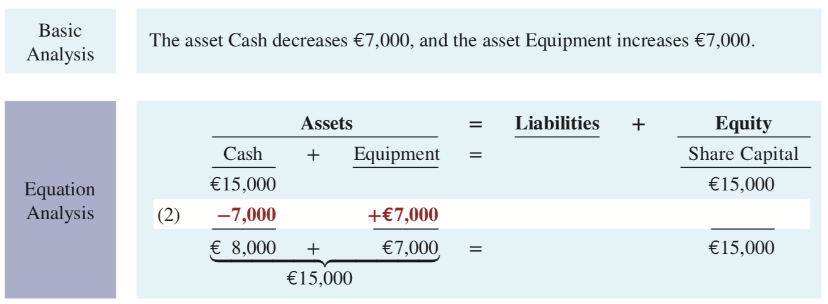
Transaction (2). Purchase of Equipment for Cash.
Assume: Softbyte SA purchases computer equipment for €7,000 cash.
Demonstrate: Basic and equation analysis of this transaction.
This transaction results in an equal increase and decrease in total assets, though the composition of assets changes.
L O 4

Slide 64
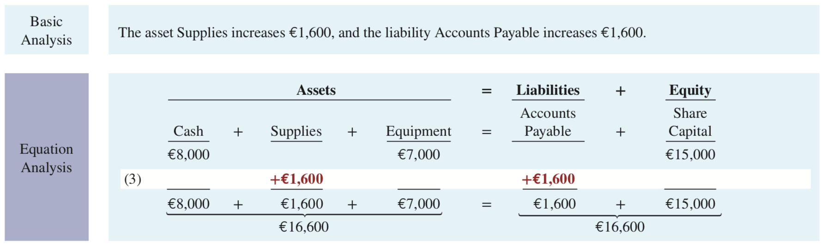
Transaction (3). Purchase of Supplies on Credit.
Assume: Softbyte SA purchases headsets (and other computer accessories expected to last several months) for €1,600 from Mobile Solutions. Mobile Solutions agrees to allow Softbyte to pay this bill in October. This transaction is a purchase on account (a credit purchase).
Demonstrate: Basic and equation analysis of this transaction.
Assets increase because of the expected future benefits of using the headsets and computer accessories, and liabilities increase by the amount due by Mobile Solutions.
L O 4
Notes:
Supplies → easy to use up sooner, less than 1 yr.
Equipment → use up longer (several yrs)
Why do we differentitate supply & equipment? In future classes, we will explore this more.

Slide 65
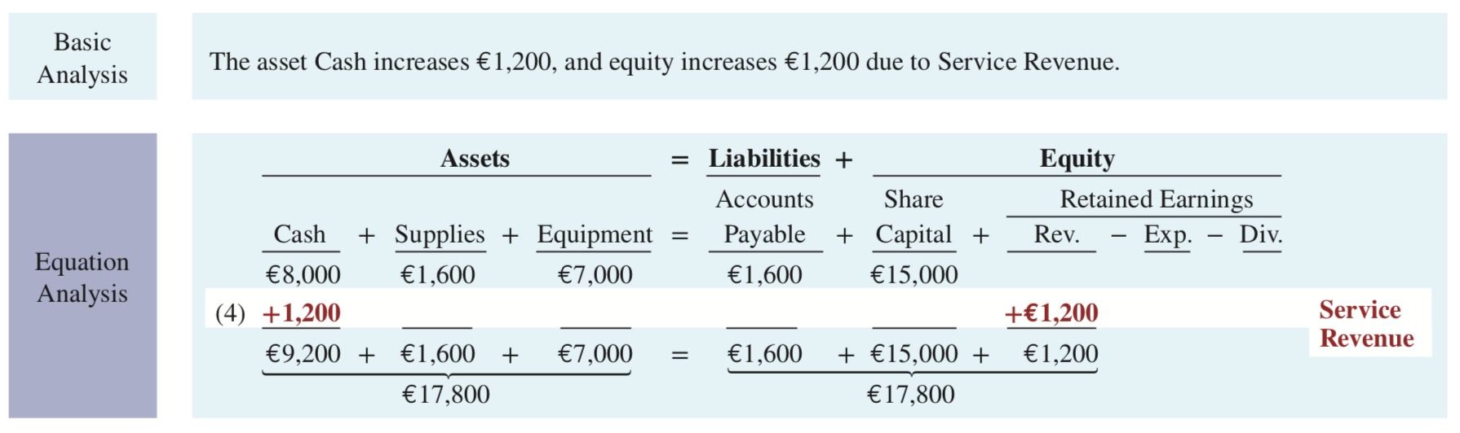
Transaction (4). Services Performed for Cash.
Assume: Softbyte SA receives €1,200 cash from customers for app development services it has performed. This transaction represents Softbyte’s principal revenue-producing activity. Recall that revenue increases equity.
Demonstrate: Basic and equation analysis of this transaction.
Recall that revenue increases equity.
L O 4

Slide 66
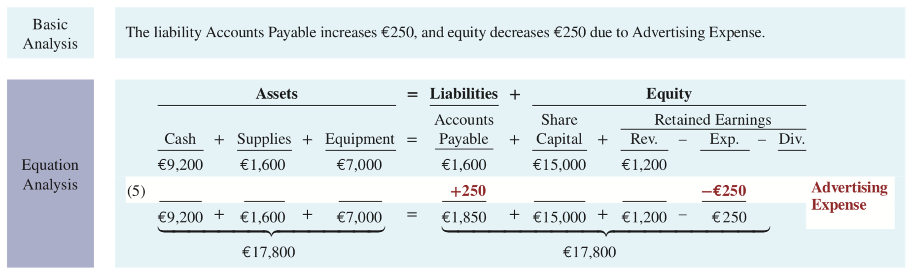
Transaction (5). Purchase of Advertising on Credit.
Assume: Softbyte SA receives a bill for €250 from Programming News for advertising on its website but postpones payment until a later date.
Demonstrate: Basic and equation analysis of this transaction.
The two sides of the equation still balance at €17,800. Retained Earnings decreases when Softbyte incurs the expense. Expenses do not have to be paid in cash at the time they are incurred. When Softbyte pays at a later date, the liability Accounts Payable will decrease and the asset Cash will decrease. The cost of advertising is an expense because Softbyte has used the benefits. Advertising Expense is included in determining net income.
L O 4

Slide 67
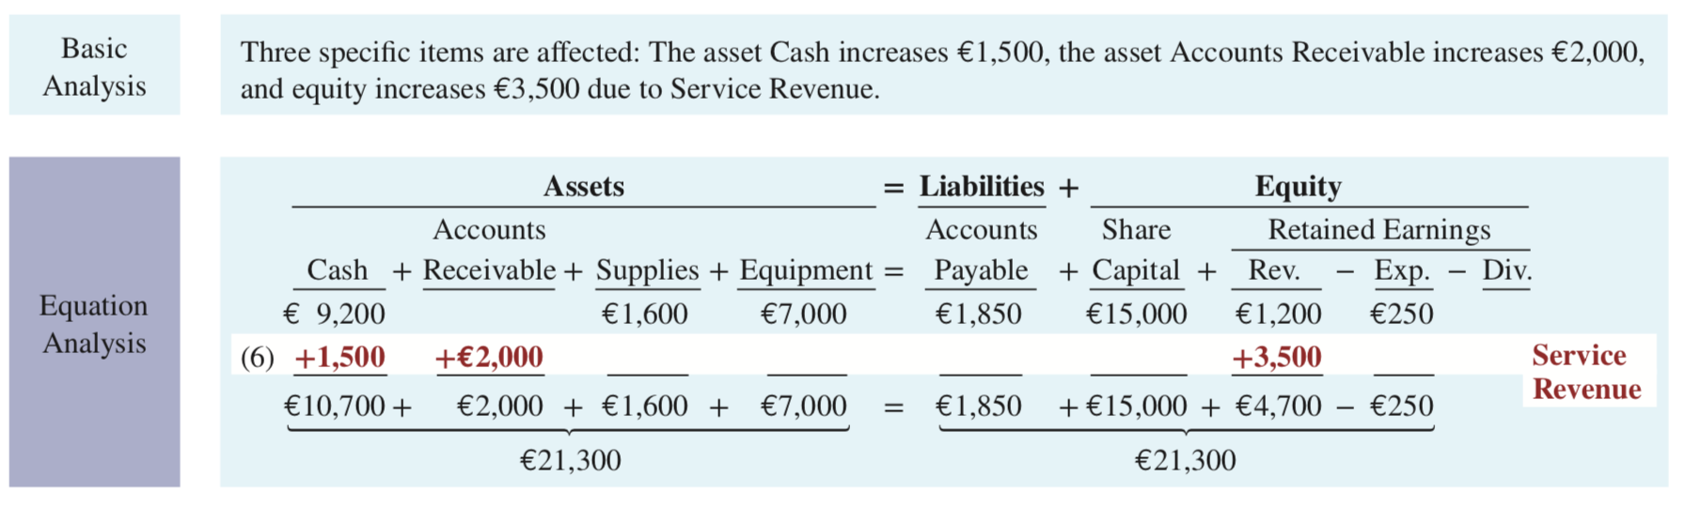
Transaction (6). Services Performed for Cash & Credit.
Assume: Softbyte SA performs €3,500 of app development services for customers. The company receives cash of €1,500 from customers, and it bills the balance of €2,000 on account.
Demonstrate: Basic and equation analysis of this transaction.
This transaction results in an equal increase in assets and equity.
L O 4

Slide 68
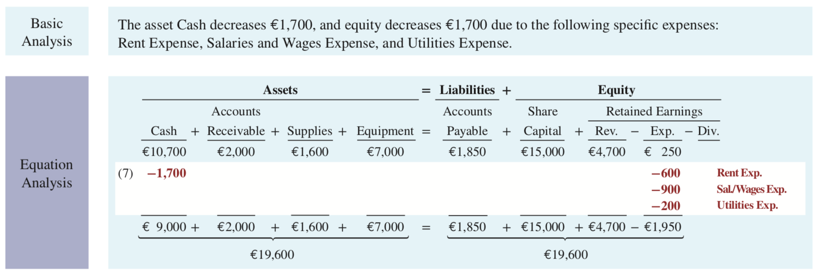
Transaction (7). Payment of Expenses.
Assume: Softbyte SA pays the following expenses in cash for September: office rent €600, salaries and wages of employees €900, and utilities €200.
Demonstrate: Basic and equation analysis of this transaction.
This transaction results in an equal decrease in assets and equity.
L O 4

Slide 69
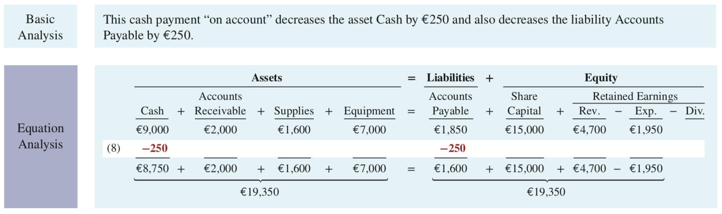
Transaction (8). Payment of Accounts Payable.
Assume: Softbyte SA pays its €250 Programming News bill in cash. The company previously [in Transaction (5)] recorded the bill as an increase in Accounts Payable and a decrease in equity.
Demonstrate: Basic and equation analysis of this transaction.
Observe that the payment of a liability related to an expense that has previously been recorded does not affect equity. Softbyte recorded the expense [in Transaction (5)] and should not record it again.
L O 4

Slide 70
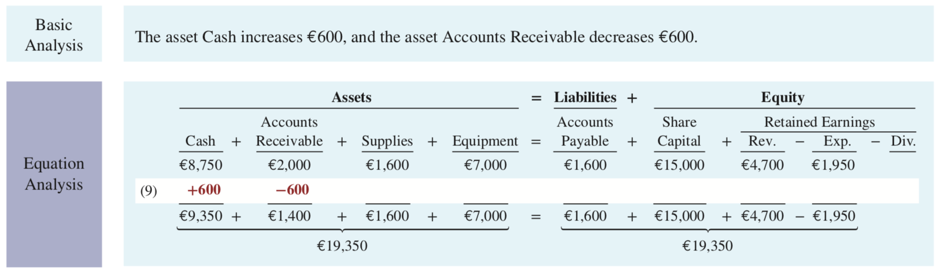
Transaction (9). Receipt of Cash on Account.
Assume: Softbyte SA receives €600 in cash from customers who had been billed for services [in Transaction (6)].
Demonstrate: Basic and equation analysis of this transaction.
Transaction (9) does not change total assets, but it changes the composition of those assets. Note that the collection of an account receivable for services previously billed and recorded does not affect equity. Softbyte already recorded this revenue [in Transaction (6)] and should not record it again.
L O 4

Slide 71
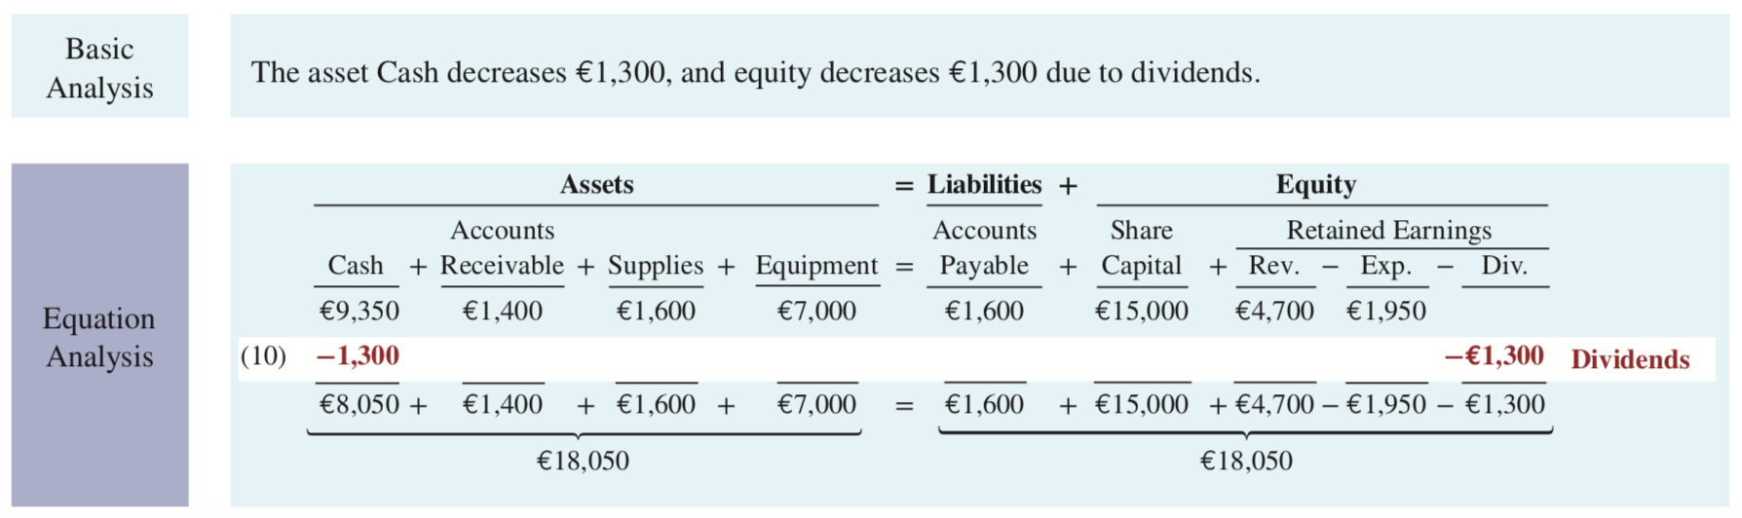
Transaction (10). Dividends.
Assume: The company pays a dividend of €1,300 in cash to Ray and Barbara Neal, the shareholders of Softbyte SA. This transaction results in an equal decrease in assets and equity.
Demonstrate: Basic and equation analysis of this transaction.
Total assets did not change, but the composition of those assets did. Note that the dividend reduces retained earnings, which is part of equity. Dividends are not expenses. Like shareholders’ investments, dividends are excluded in determining net income.
L O 4

Slide 72
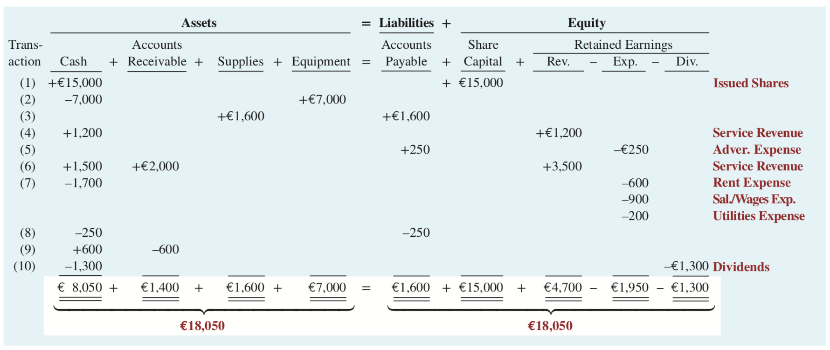
Tabular Summary
Illustration 1.10: Tabular summary of Softbyte SA transactions
L O 4
Notes:
In reality, we don’t record numbers this way. This is just an example. Next week, we will look at formal way to record.

Slide 73
Summarizing Transactions Key Points
Each transaction must be analyzed in terms of its effect on:
The three components of the basic accounting equation.
Specific types (kinds) of items within each component.
The two sides of the equation must always be equal.
The Share Capital—Ordinary and Retained Earnings columns indicate the causes of each change in the shareholders’ claim on assets.
L O 4

Slide 74
DO IT! 4: Tabular Analysis
Transactions made by Virmari & Co., a public accounting firm in France, for the month of August are shown below. Prepare a tabular analysis which shows the effects of these transactions on the expanded accounting equation, similar to that shown in Illustration 1.10.
The company issued ordinary shares for €25,000 cash.
The company purchased €7,000 of office equipment on credit.
The company received €8,000 cash in exchange for services performed.
The company paid €850 for this month’s rent.
The company paid a dividend of €1,000 in cash to shareholders.
L O 4

Slide 75
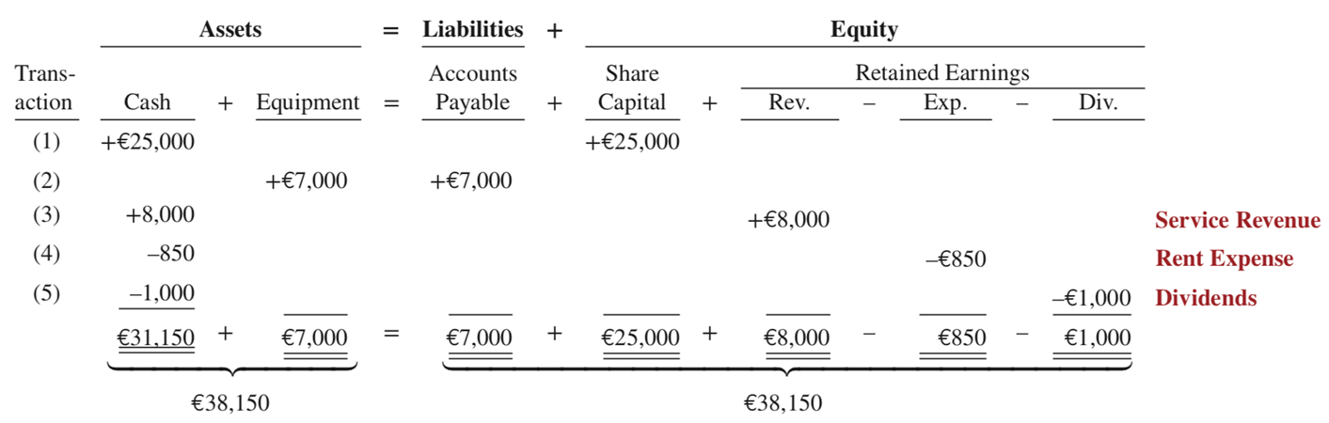
DO IT! 4: Tabular Analysis – Solution
L O 4

Slide 76
Learning Objective 5 Describe the five financial statements and how they are prepared.
L O 5

Slide 77
Financial Statements
Income statement: presents the revenues and expenses and resulting net income or net loss for a specific period of time.
Retained earnings statement: summarizes the changes in retained earnings for a specific period of time.
Statement of financial position: reports the assets, liabilities, and equity of a company at a specific date. (Sometimes referred to as a balance sheet.)
Statement of cash flows: summarizes information about the cash inflows (receipts) and outflows (payments) for a specific period of time.
Comprehensive income statement: presents other comprehensive income items that are not included in the determination of net income in 1.
L O 5

Slide 78
Income Statement
The income statement lists revenues first, followed by expenses. Then, the statement shows net income (or net loss).
Structure:
The income statement lists revenues first, followed by expenses.
Then, the statement shows net income (or net loss).
When revenues exceed expenses, net income results.
When expenses exceed revenues, a net loss results.
The income statement does not include investment and dividend transactions between the shareholders and the business in measuring net income.
L O 5

Slide 79
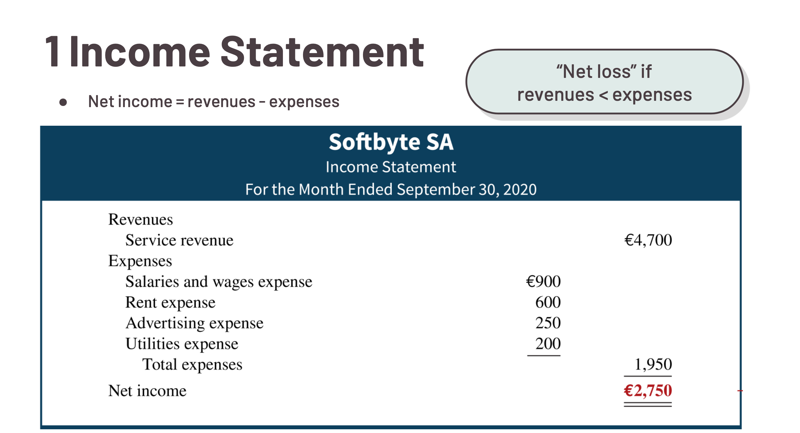
Notes:
Income statement list revenue first, followed by expense. Statement shows net income (or net loss) depending on outcome.
If Revenue > Expense, net income
If Revenue < Expense, net loss.
Does not include contributed capital and dividends.

Slide 80
Retained Earnings Statement
The information provided by this statement indicates the reasons why retained earnings increased or decreased during the period. If there is a net loss, it is deducted with dividends in the retained earnings statement.
Structure:
The first line of the statement shows the beginning retained earnings amount.
Then add net income (or subtract net loss) and subtract dividends.
The retained earnings ending balance is the final amount on the statement.
L O 5

Slide 81
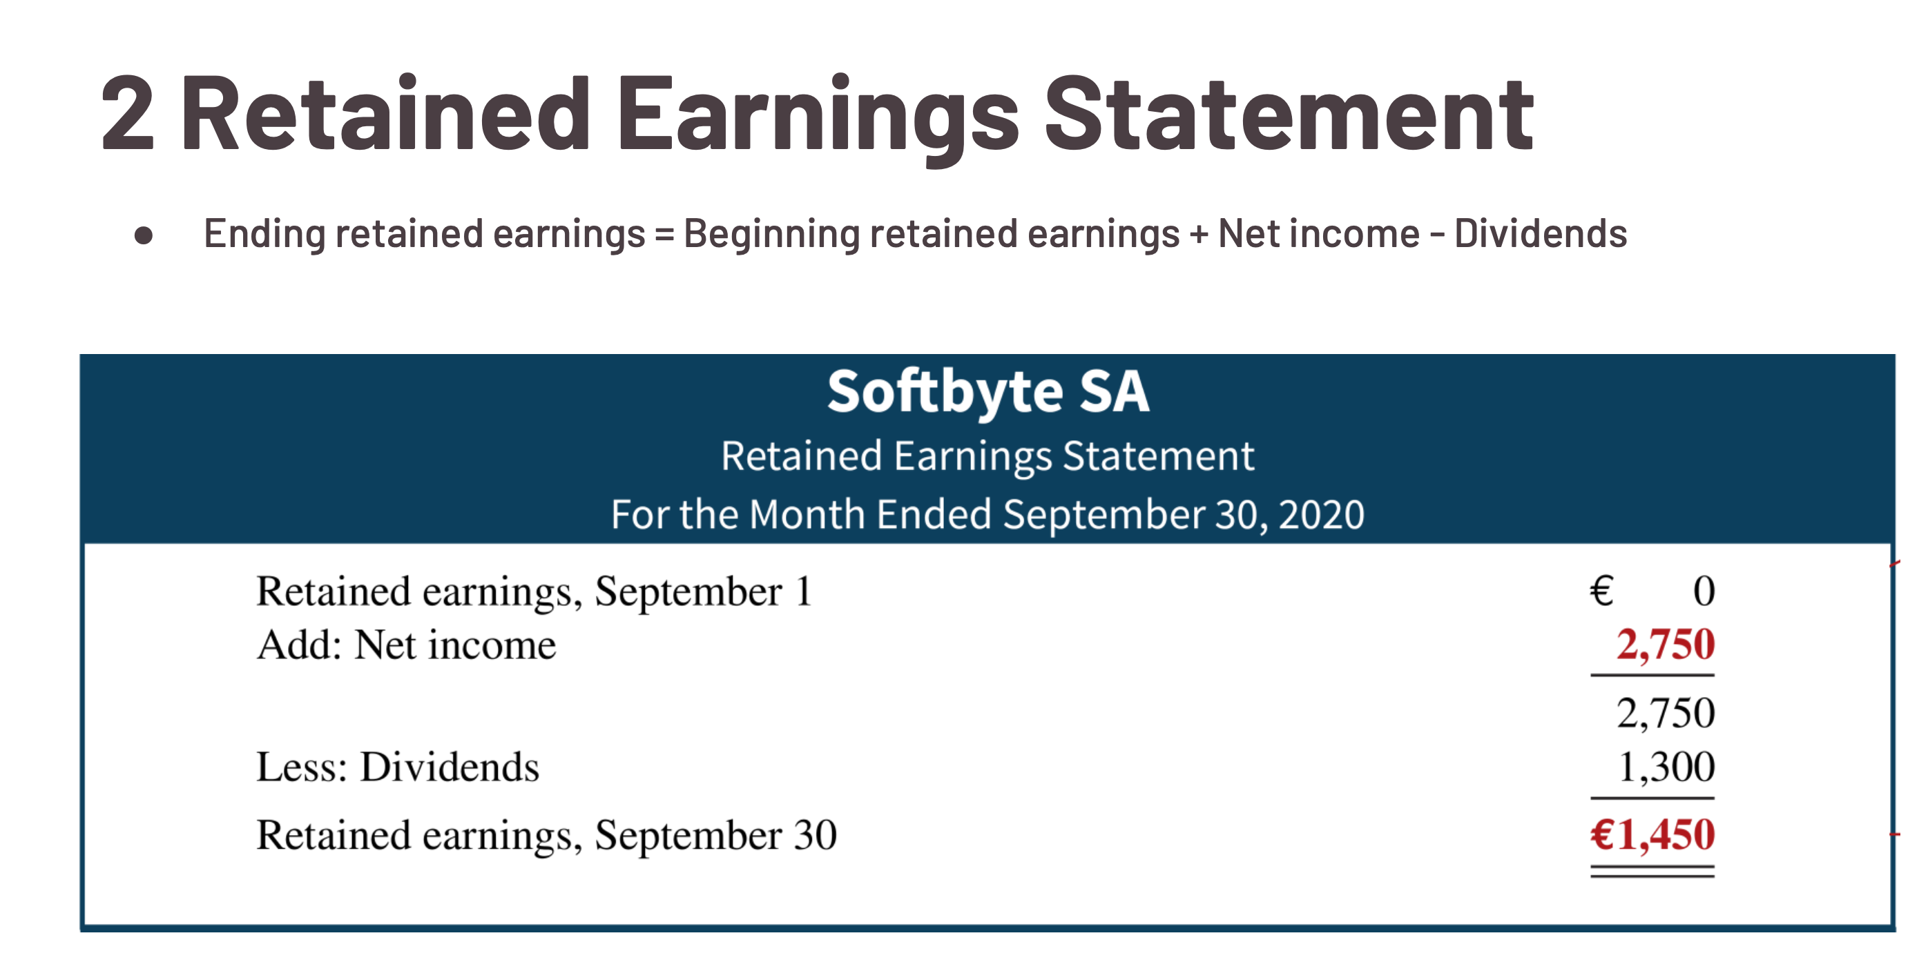
Statement of Retained Earnings
Notes:
Statmenet of retained earnings indicates reasons why retained earnings increased or decreased during period.
The first line of the statement shows the beginning retained earnings amount.
Then add net income (or subtract net loss) and subtract dividends.
The retained earnings ending balance is the final amount on the statement.

Slide 82
Balance Sheet/Statement of financial position
a levels statement that presents, for a given point in time:
the firm’s assets (economic resources)
the firm’s liabilities (economic obligations to outsiders)
the firm’s shareholders’ equity (financing provided by shareholders), comprised of
contributed capital (owners’ direct investment in the firm)
retained earnings (income retained in the business and not paid out to shareholders)
other items (not discussed in this course)
Shareholders are considered to be the residual claimants in the firm
The total value of shareholders’ equity is sometimes called the firm’s book value

Slide 83
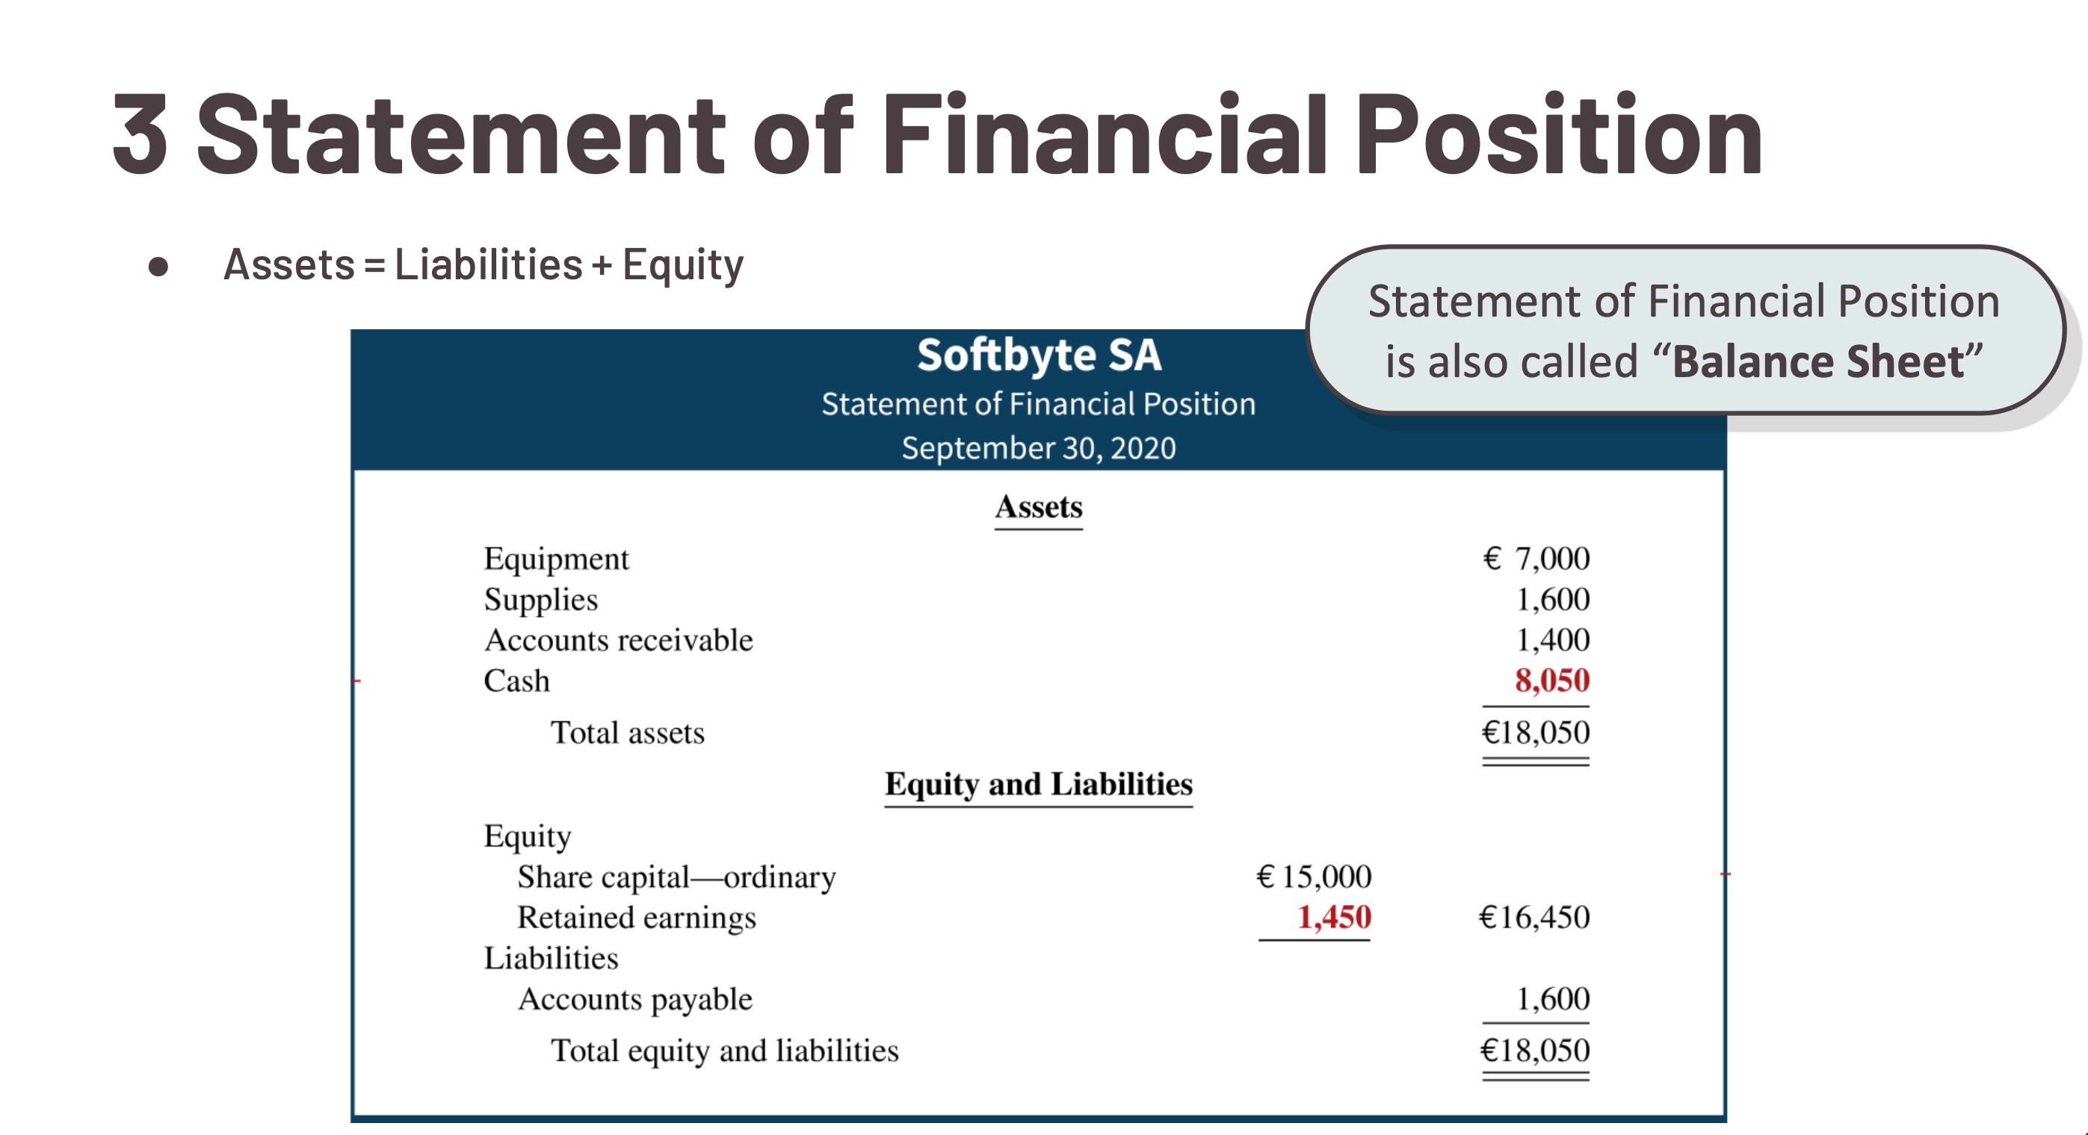
Balance Sheet
Notes:
Balance sheet is a snapshot of a firm at a given point in time.
Present assets (economic resources), liabilities (economic obligations), and shareholders equity, which comprise of contributed capital and retained earnings.

Slide 84
Statement of Cash Flows
The statement of cash flows provides information on the cash receipts and payments for a specific period of time.
Structure:
The statement of cash flows reports
the cash effects of a company’s operations during a period,
its investing activities,
its financing activities,
the net increase or decrease in cash during the period, and
the cash amount at the end of the period.
L O 5

Slide 85
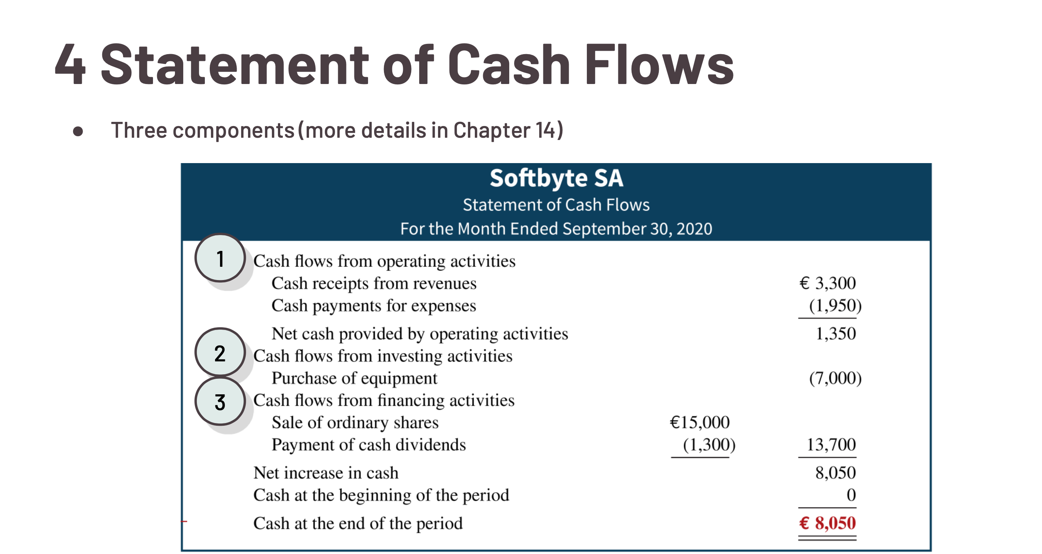
Notes:
SCF reports companies
Cash from companies operations (CF from operating)
Cash from investing activities (CF from operating)
Cash from financing activities (CF from financing)
Net increase or decrease in cash during period
And cash at end of period.

Slide 86
Net Income Review Question
Net income will result during a time period when:
assets exceed liabilities.
assets exceed revenues.
expenses exceed revenues.
revenues exceed expenses.
L O 5

Slide 87
Net Income – Solution
Net income will result during a time period when:
assets exceed liabilities.
assets exceed revenues.
expenses exceed revenues.
revenues exceed expenses. (Correct)
L O 5

Slide 88
Link between income statement and balance sheet Assets = Liabilities + Equity End period Retained earning = beginning period RE + NI – Div

Slide 89






DO IT! 5: Financial Statement Items
Presented below is selected information related to Li Fashions at December 31, 2025. Li reports financial information monthly.
Equipment | HK$10,000 | Utilities Expense | HK$ 4,000
Cash | 8,000 | Accounts Receivable | 9,000
Service Revenue | 36,000 | Salaries and Wages Expense | 7,000
Rent Expense | 11,000 | Notes Payable | 16,500
Accounts Payable | 2,000 | Dividends | 5,000
Determine the total assets of Li at December 31, 2025.
Determine the net income that Li reported for December 2025.
Determine the equity of Li at December 31, 2025.
L O 5

Slide 90
DO IT! 5: Financial Statement Items (A)
Presented below is selected information related to Li Fashions at December 31, 2025. Li reports financial information monthly.
Equipment | HK$10,000 | Utilities Expense | HK$ 4,000
Cash | 8,000 | Accounts Receivable | 9,000
Service Revenue | 36,000 | Salaries and Wages Expense | 7,000
Rent Expense | 11,000 | Notes Payable | 16,500
Accounts Payable | 2,000 | Dividends | 5,000
A
Exp
A
A
Rev
Exp
Exp
Liab
Liab
Div
Determine the total assets of Li at December 31, 2025.
Determine the net income that Li reported for December 2025.
Determine the equity of Li at December 31, 2025.
L O 5
Notes:
Asset = 10000 + 8000 + 9000 = 27000
Net Income = Rev – Exp = 36000 – 11000 – 4000 – 7000 = 14000
Equity = A – L = 27000 – (2000 + 16500) = 8500

Slide 91
DO IT! 5: Financial Statement Items – Solution
The total assets are HK$27,000, comprised of Equipment HK$10,000, Account Receivable HK$9,000, and Cash HK$8,000.
Net income is HK$14,000, computed as follows.
Revenues
Service revenue |  | HK$36,000
Expenses
Rent expense | HK$11,000
Salaries and Wages expense | 7,000
Utilities expense | 4,000
Total expenses |  | 22,000
Net income |  | HK$14,000
L O 5

Slide 92
Learning Objective 6 Explain the career opportunities in accounting.
L O 6

Slide 93
Career Opportunities in Accounting
Why is accounting such a popular major and career choice?
Public Accounting (big 4) Individuals in public accounting offer expert service to the general public, in much the same way that doctors serve patients and lawyers serve clients. Choices: Auditing, taxation, management consulting
Private Accounting Individuals in private accounting are employees of for-profit companies and not-for-profit organizations. Choices: Cost accounting, budgeting, accounting information system design and support, tax planning and preparation, internal auditing
L O 6

Slide 94
Additional Career Opportunities in Accounting
Why is accounting such a popular major and career choice?
Governmental Accounting Choices: Tax authorities, local governments, law enforcement agencies, company regulators, accounting educators at public colleges and universities
Other opportunities
Transition into finance
Academics
L O 6

Slide 95
Copyright
Copyright © John Wiley & Sons, Inc.
All rights reserved. Reproduction or translation of this work beyond that permitted in Section 117 of the 1976 United States Act without the express written permission of the copyright owner is unlawful. Request for further information should be addressed to the Permissions Department, John Wiley & Sons, Inc. The purchaser may make back-up copies for his/her own use only and not for distribution or resale. The Publisher assumes no responsibility for errors, omissions, or damages, caused by the use of these programs or from the use of the information contained herein.

